Slide 1
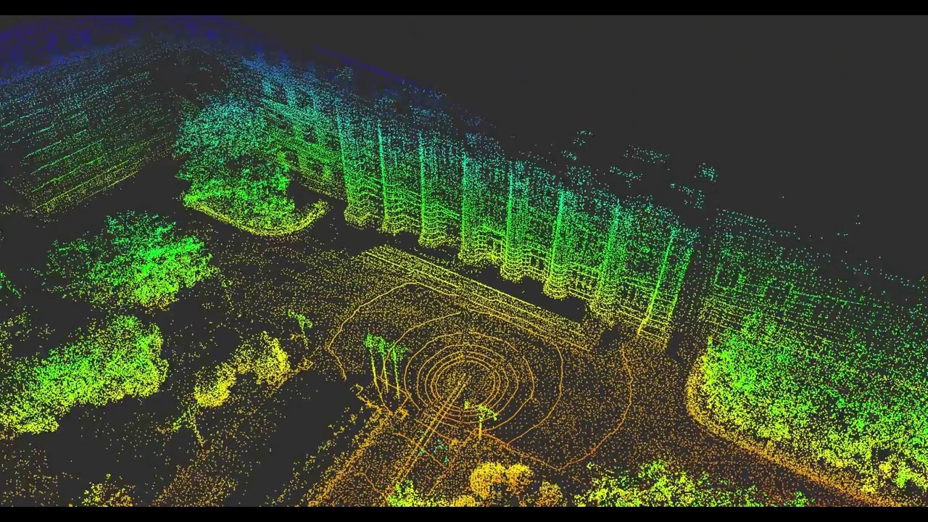
Robotic Perception
RGB Light Landmark-Based SLAM
Instructor:
Srikanth Saripalli
Group Members:
Kuan Wei Liu
Li-Tsung Lin
Ju-Hsuan Chang
Jui-Chun Yang
Yen-Hsiang Huang

Slide 2



Outline
Objective
Method
Experiment

Slide 3
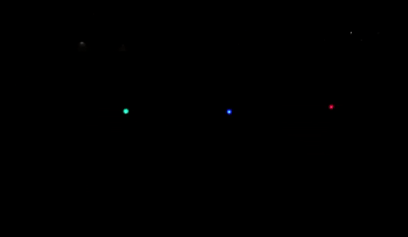
Objective
Localize the robot and map the environment with landmarks.
Problem statement:
Given y-coordinate of the three landmarks, robot’s motion(sensor
data), distance between the robot and landmarks(measurement
data), localize the robot’s coordinate and find x-coordinate of the
three landmarks.

Slide 4
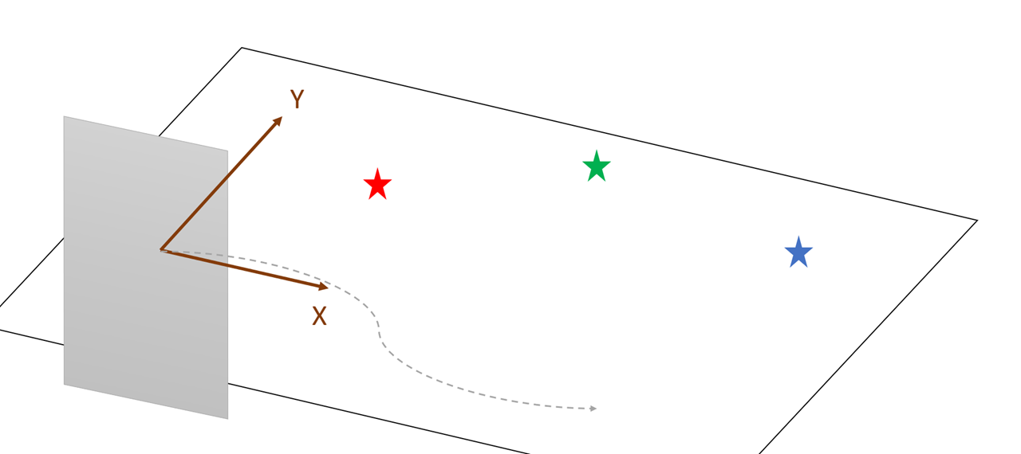
Setup
Localize
Robot – smartphone
Landmarks – Red, Green, and Blue LED lights
A smartphone with a camera facing Y-direction. Moving the smartphone randomly without changing its orientation

Slide 5
Data Collection
Collecting accelerometer, GPS, gyroscope, and magnetometer data from the smartphone -> motion propagation
Collecting images of each light source from the video and calculate the corresponding distances between the phone and lights -> measurement

Slide 6
Data Collection - Motion Data
Compute the rotation matrix of the smartphone by its accelerometer, gyroscope and magnetometer.
Multiply the accelerometer data by the rotation matrix.
Perform accelerometer & GPS sensor fusion with Extended Kalman Filter.
Obtain the displacement by dead reckoning.

Slide 7
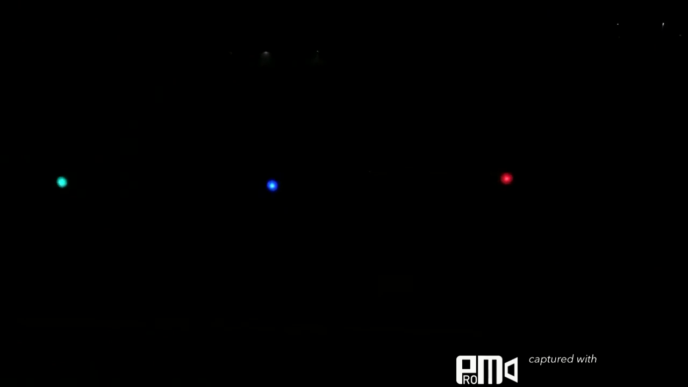
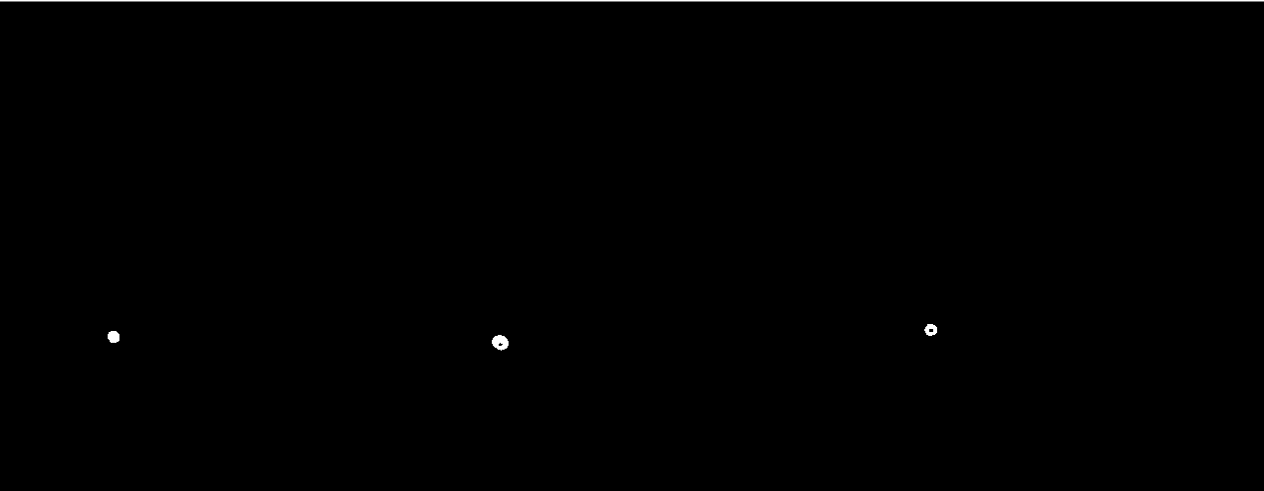
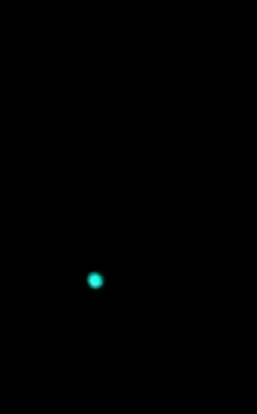
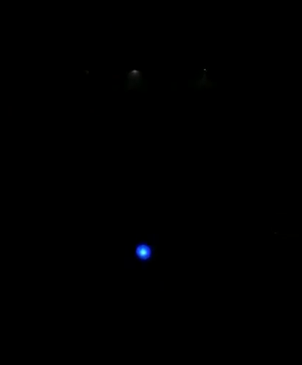
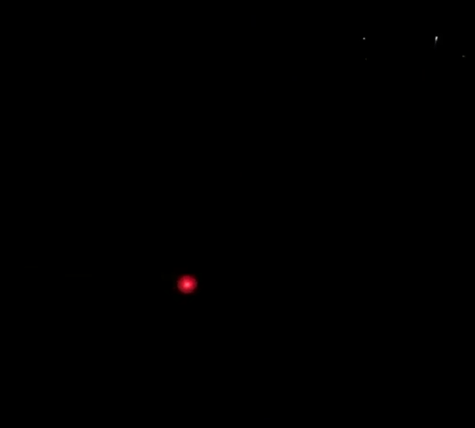

Data Collection - Video Image Processing
Detect the
Light regions
Divide the image
Calculate Areas &
Convert to distances

Slide 8
Data Collection - Distance Converter Calibration
Record the calibration video of the landmarks from 90cm to 500cm with interval of 20cm.
Determine the relationship between the area of object and distance by curve fitting

Slide 9
Method 1: EKF SLAM
Use Extended Kalman filter to estimate the location of the phone
Algorithm
Assume an initial state
Predict the movement of the phone by applying sensors information(ΔX, ΔY)
Update measurement data (distance between the phone and landmarks)
Update mean of the state and covariance matrix

Slide 10
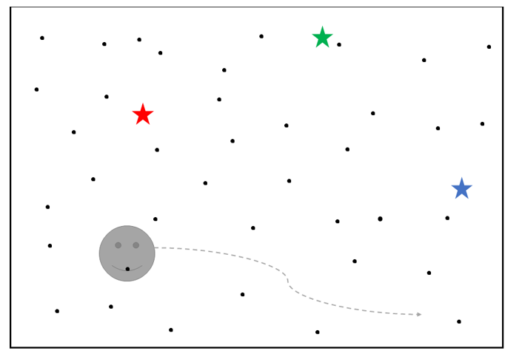

Method 2: Particle filter SLAM
Use particle filter to estimate the location of the phone. Each particle contains positions of the three landmarks and covariance matrix, which means each particle holds three individual EKFs.
Each particle contains states:

Slide 11
Algorithm
Scatter particles in the map randomly
Predict the movement of the particles by applying sensors information(ΔX, ΔY)
Update measurement data (distance between the phone and landmarks)
Resample the particles and go back to step 2.

Slide 12
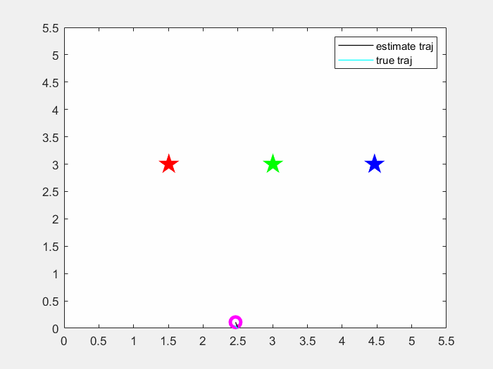
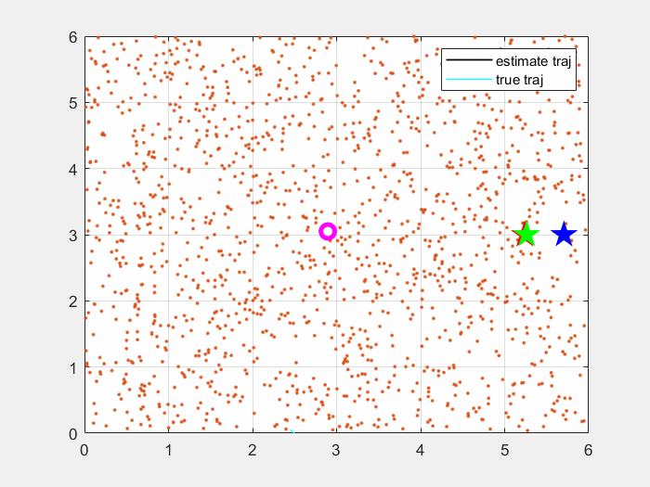
Performance test
EKF SLAM
Particle filter SLAM
Position Y (m)
Position Y (m)
Position X (m)
Position X (m)

Slide 13
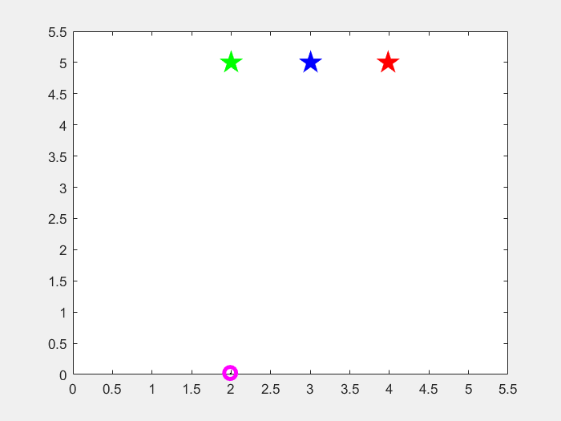
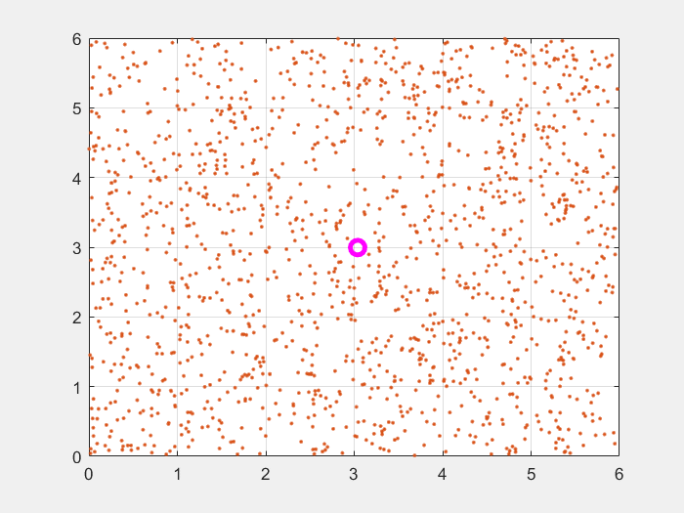
Experiment Result
EKF SLAM
Particle filter SLAM
Position Y (m)
Position Y (m)
Position X (m)
Position X (m)

Slide 14
Conclusion
Performance test shows that the two algorithm are reliable.
In experiment, the particle filter failed to localize while EKF perform better, which is caused by different initial assumption.
Both particle filter SLAM and EKF SLAM perform well only when noise is acceptable

Slide 15


Slide 16
Detail steps in updating measurement data
If observe a new feature
Initialize mean
Calculate Jacobian matrix
Initialize covariance
Assume a weight
Else
Predict the measurement with sensor data(dx dy)
Calculate Jacobian matrix
Update measurement covariance with the new Jacobian matrix
Calculate the Kalman gain
Update mean
Update covariance
Calculate the weight of each particle (importance factor)

